Slide 1
Perfect Competition: Part 1
Steven Suranovic
George Washington University

Slide 2
Effects of Competition
Monopoly to Duopoly (2 firms)
Duopoly to Oligopoly (Small number of firms)
Oligopoly to Perfect Competition (many, many firms)

Slide 3
Perfect Competition: Setting the Stage
Highly stylized representation of a simple economy
Simplification makes the model tractable
PC is the basis for the most used economic tool:
supply and demand curves
Best examples of PC markets are agricultural goods
Many small farms supply a large market for corn, rice, wheat, etc.

Slide 4
Perfect Competition: Setting the Stage
A PC market will be shown to have very positive characteristics vis-à-vis economic efficiency
Most accept that a PC market is not an accurate description of the real world, but ….
It remains a very useful simplification of the world because it provides a frame for comparison
For example, we can inquire what would be needed to make a real world market more like a PC market

Slide 5
Perfect Competition Assumptions
Many small firms
Each one too small to influence market conditions
All firms are identical → same cost functions
Output is homogeneous across all firms
Many consumers of the product (demand curve)
Perfect information about prices, costs, etc.
Firms seek to maximize profit
In the long-run, free entry and exit of firms

Slide 6
Perfect Competition (PC) Features
A PC firm takes the market price as fixed, knowing that changing its quantity (q) cannot affect the price
In this case, MR = P …. Why?

Slide 7
Perfect Competition (PC) Features
A profit-maximizing perfectly competitive firm will choose their output level such that it satisfies the following condition:
P = MC
Note that since MR = P, the above is the same condition as a monopolist, but adjusted due to the smallness assumption

Slide 8
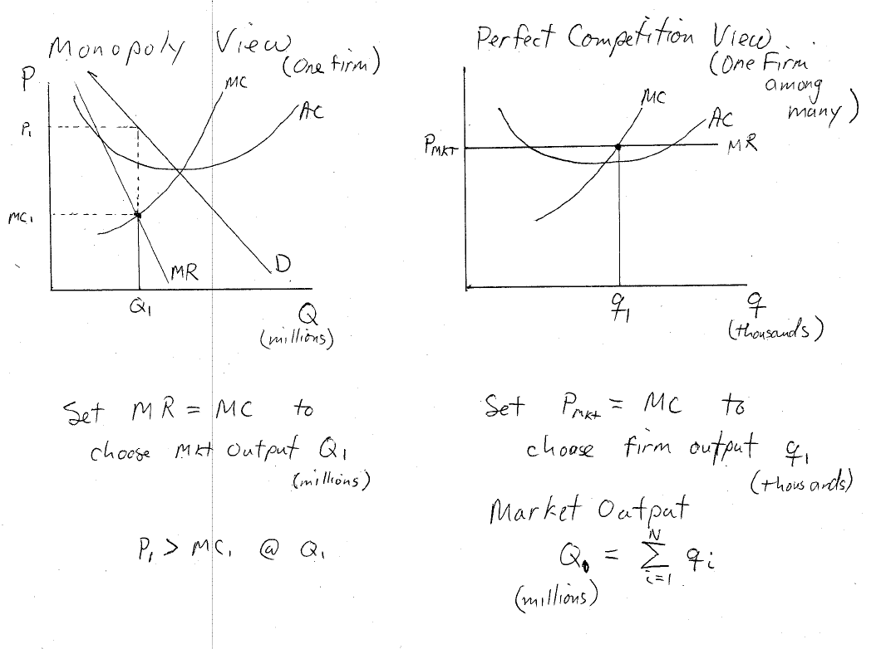

Slide 9
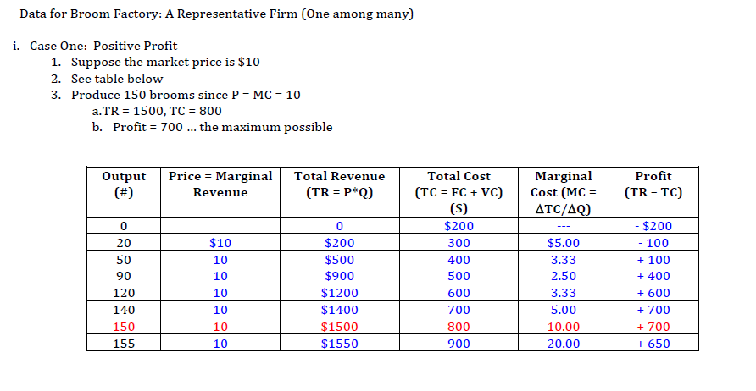

Slide 10
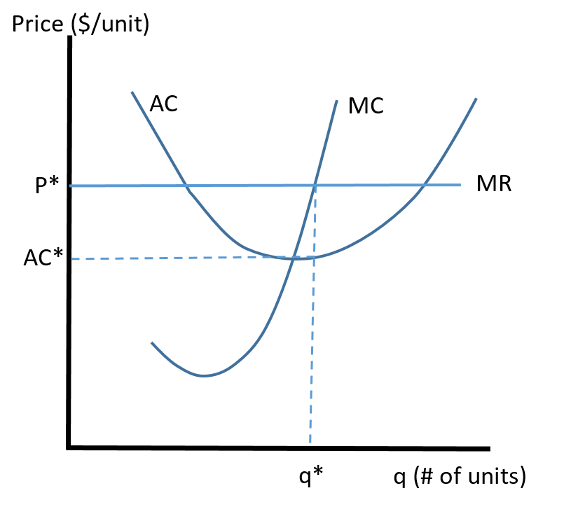
Positive Profit Outcome in PC
To Max profit, firm chooses output, q*, such that P = MC
At q*, AC(q*) = AC*
TR = P* x q*
TC = AC* x q*
π = (P* – AC*) x q* > 0

Slide 11
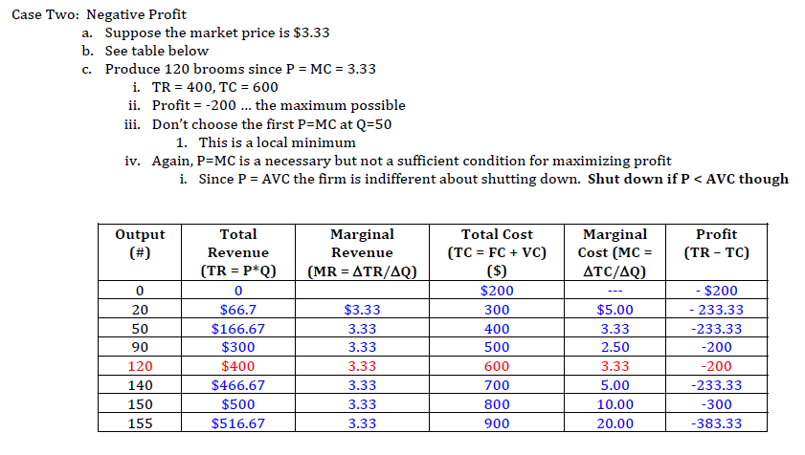

Slide 12
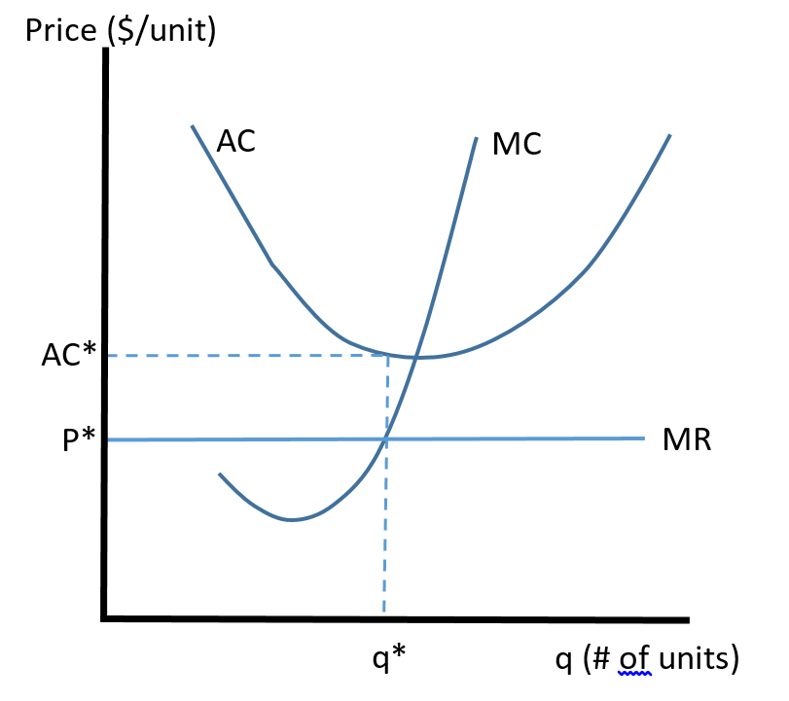
Negative Profit Outcome in PC
To Max profit, firm chooses output, q*, such that P = MC
At q*, AC(q*) = AC*
TR = P*q*
TC = AC*q*
π = (P* – AC*)q* < 0

Slide 13
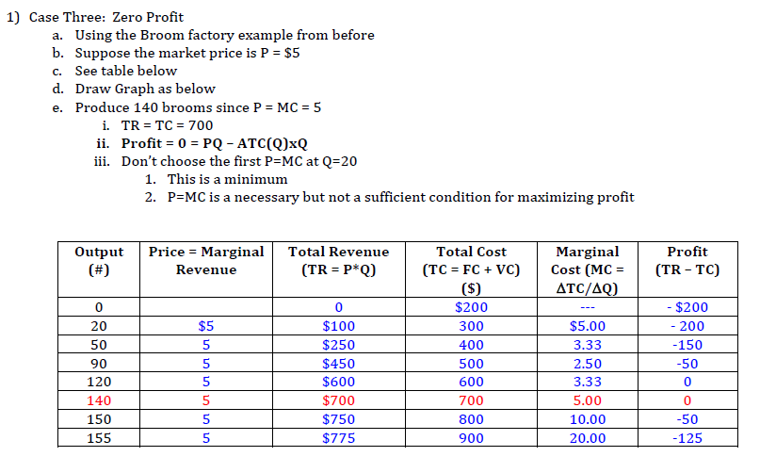

Slide 14
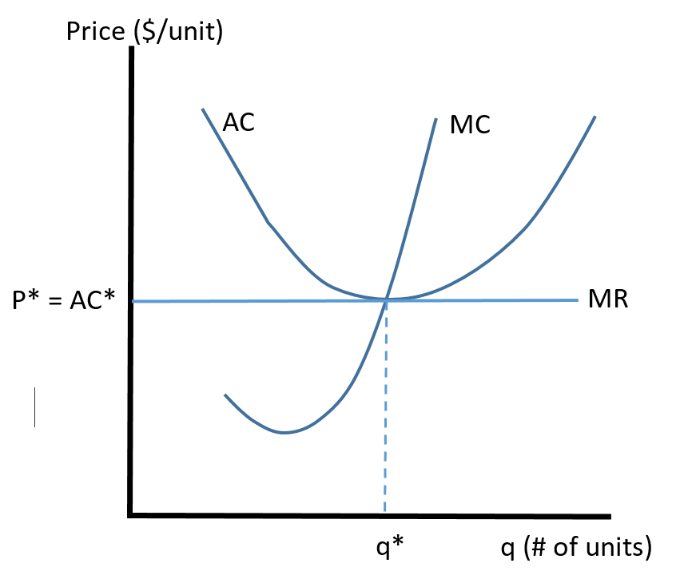
Zero Profit Outcome in PC
To Max profit, firm chooses output, q*, such that P = MC
At q*, AC(q*) = AC*
TR = P*q*
TC = AC*q*
π = (P* – AC*)q* = 0

Slide 15
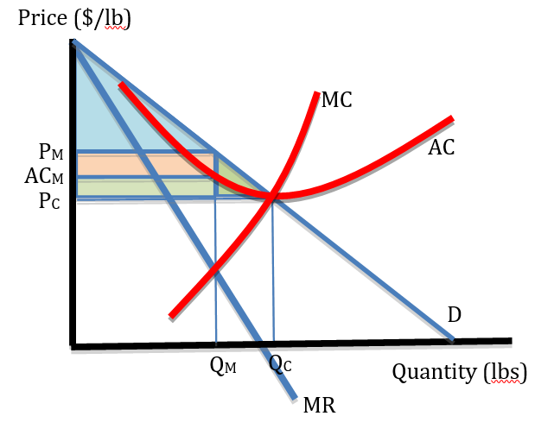
Comparing Monopoly and PC
Assume a monopoly controls all N small firms (factories) perhaps via mergers
MC = horizontal sum of all N firm MC’s
AC = horizontal sum of all N firm AC’s

Slide 16
Comparing Monopoly and PC
Monopoly result
Q = QM
P = PM
CS = blue triangle
Profit = orange rectangle
PC Result
Q = QC
P = PC
CS = all shaded areas
Profit = 0

Slide 17
Comparing Monopoly and PC
Effects of PC
Producers are made worse-off (rel. to monopoly because profits fall to zero)
Consumers are much better-off
Consumer gains exceed producer losses →
Market welfare increases with PC

